Slide 1
AIML CA2 Part A
By Davian

Slide 2
Overview Of The Workflow
Data Preprocessing
Checking Time Series Data
Tuning Hyperparameters Of Model
Conclusion
Selecting Best Model Parameters

Slide 3
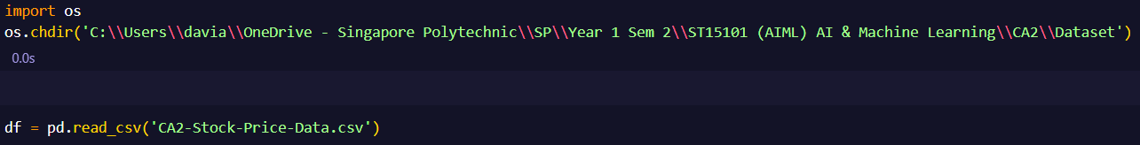
Importing Data
Using the Pandas module to import the time series dataset

Slide 4
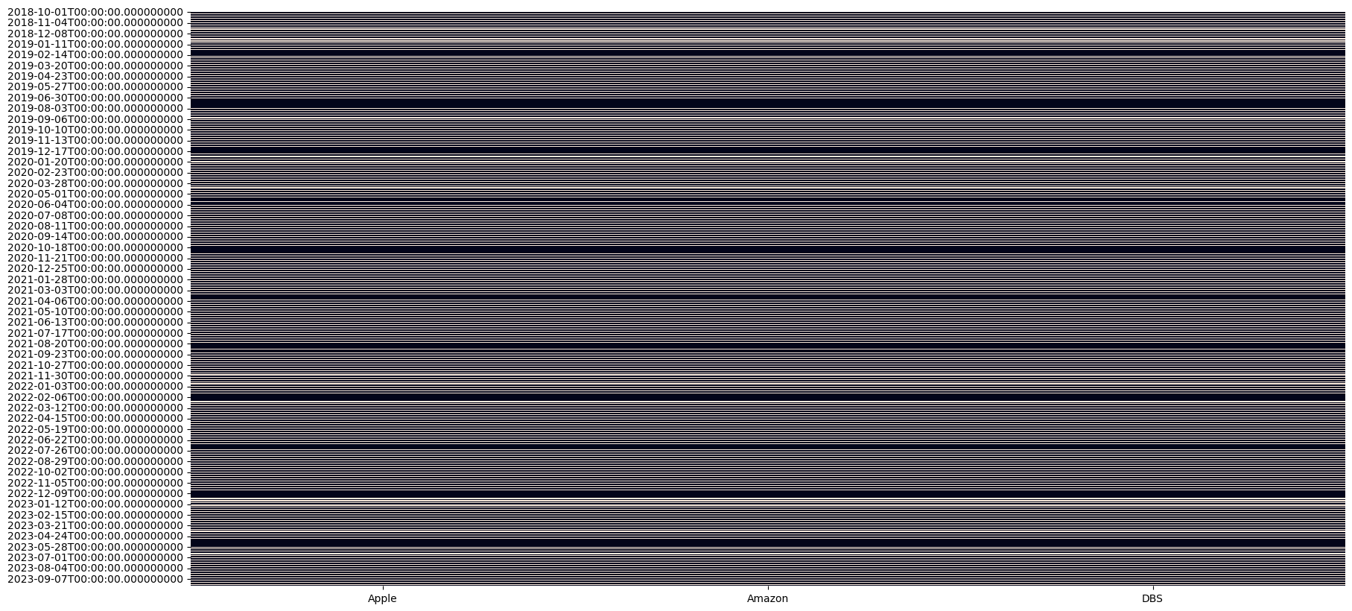
Preparing the Data
It was found that there were missing data for a few dates in the dataset and therefore imputation is needed. To impute I will use the forward fill method.

Slide 5
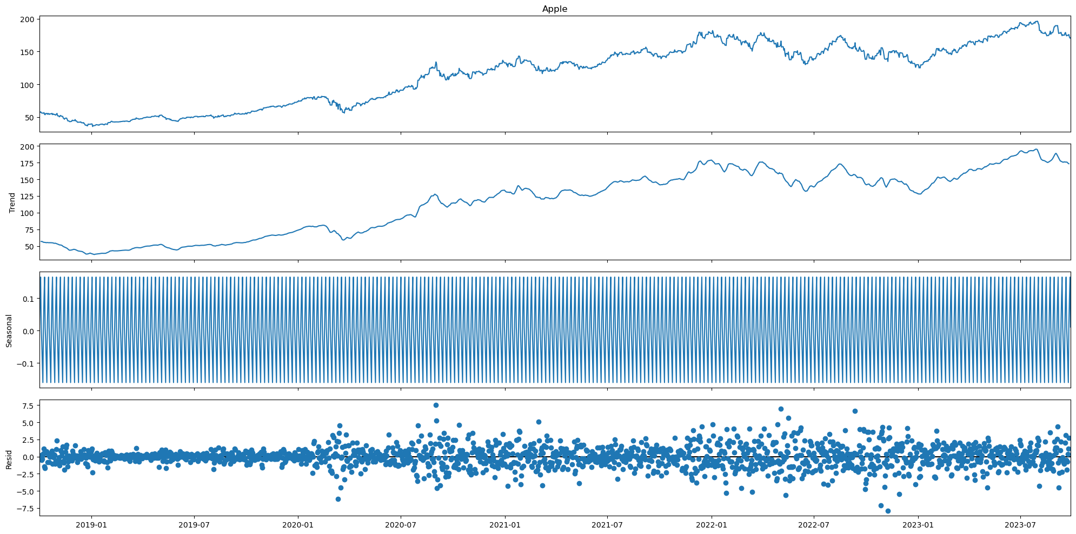
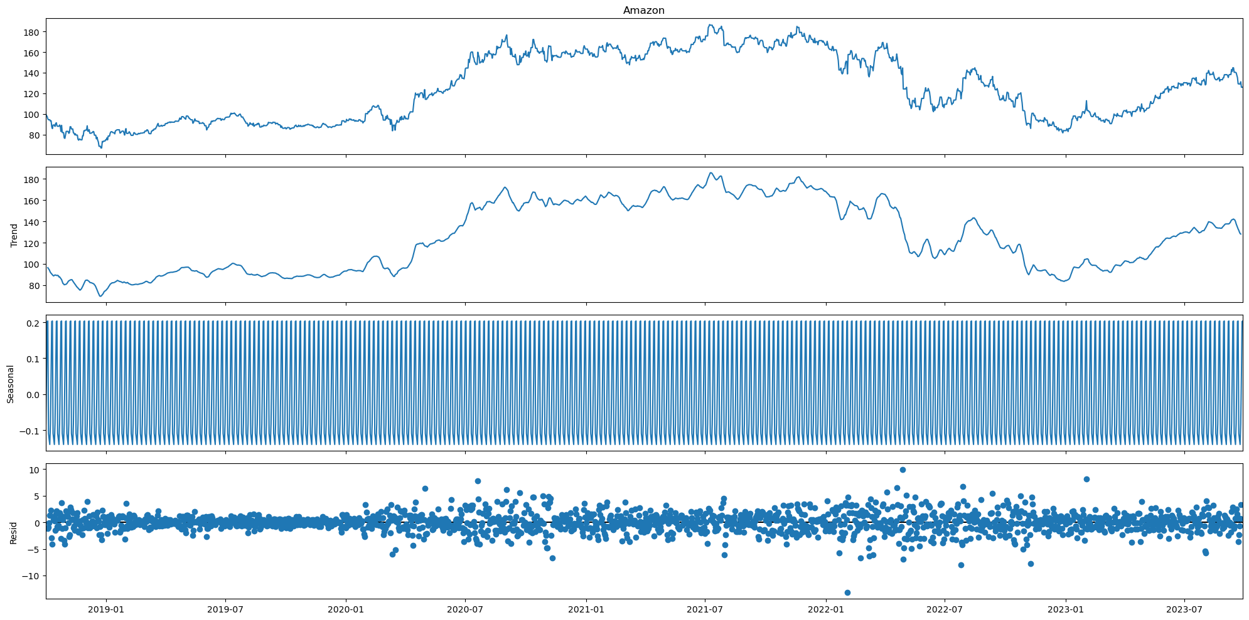
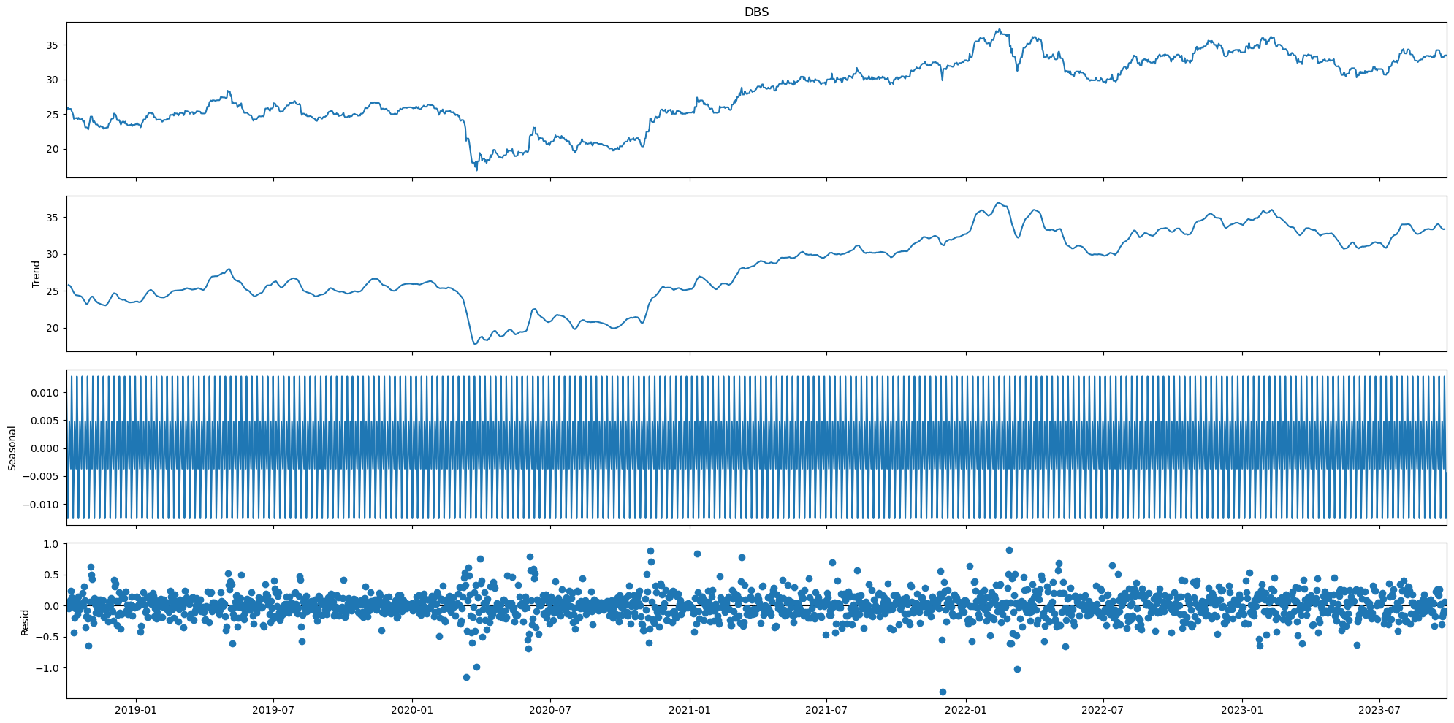
Time Series Decomposition
The next step is to decompose the time series data to look for trends and seasons in the dataset.

Slide 6
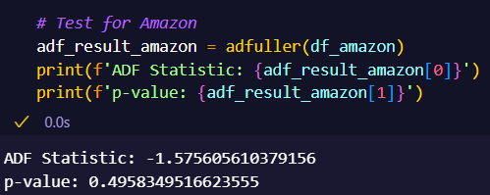
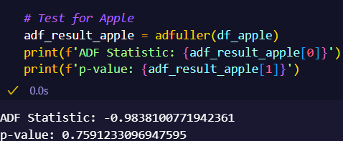
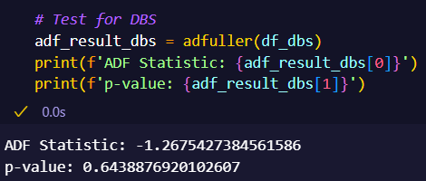
Checking Stationarity of Time Series
The next step is to do ADF test on all 3 datasets to check if the time series is stationary.
As you can see, the p-value for all 3 datasets is larger than 0.05 and therefore we can't reject the null hypothesis of non-stationarity, in favour of non-stationarity.
We will have to convert the time series into a stationary series using differencing.

Slide 7
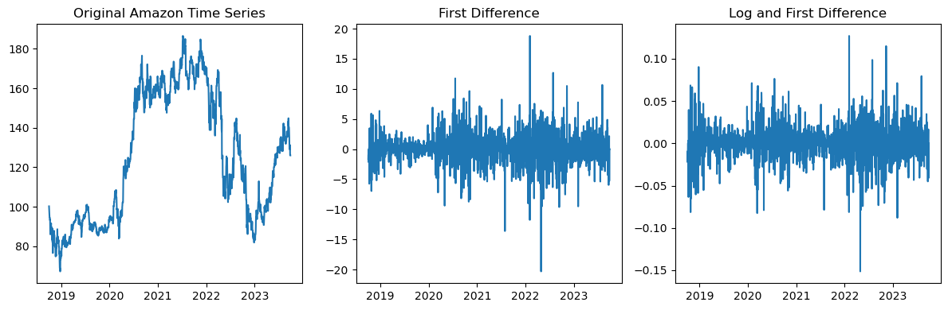
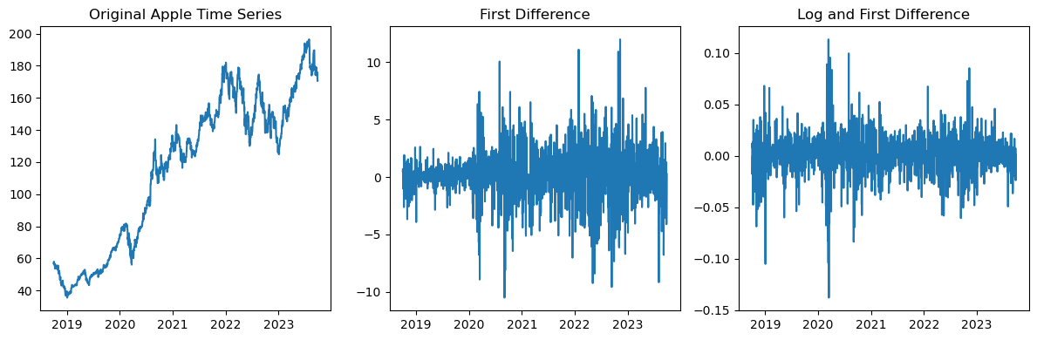
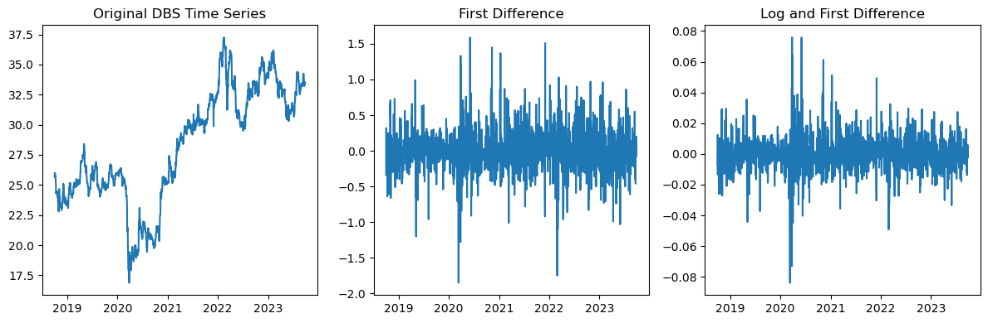
Differencing Time Series
We have converted all the time series data into its first difference and we have also log it to ensure homoscedasticity.

Slide 8
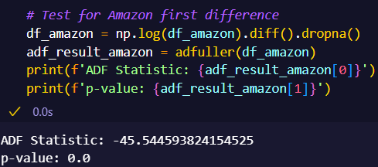
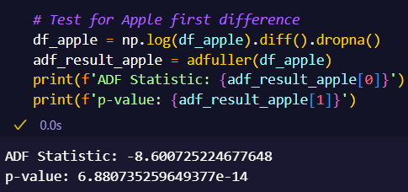
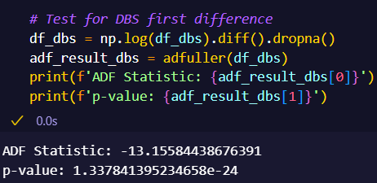
Checking Stationarity of First Difference
As the p-value for all 3 datasets are now less than 0.05, all 3 time series datasets are stationary.

Slide 9
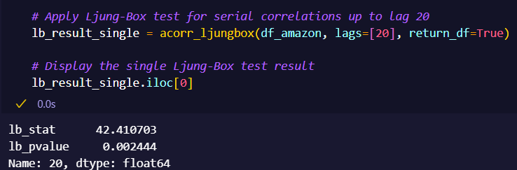
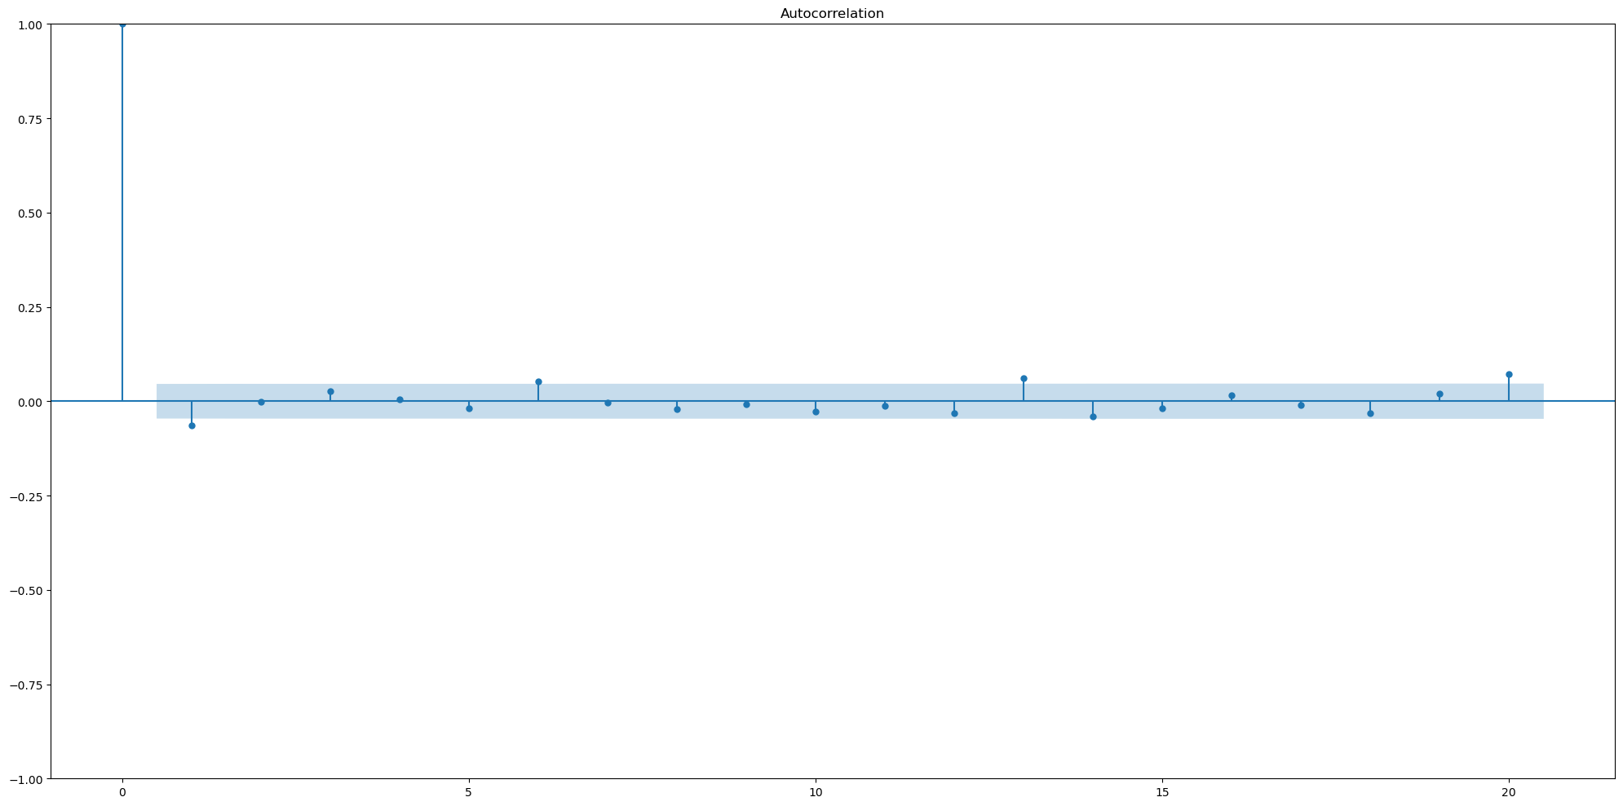
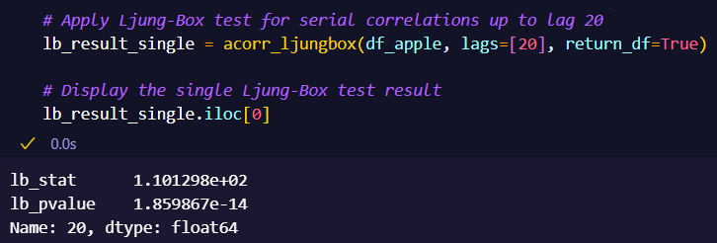

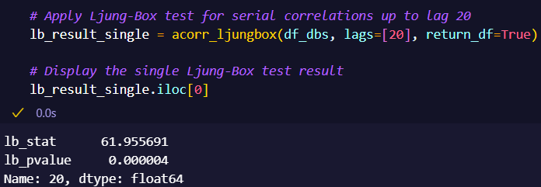
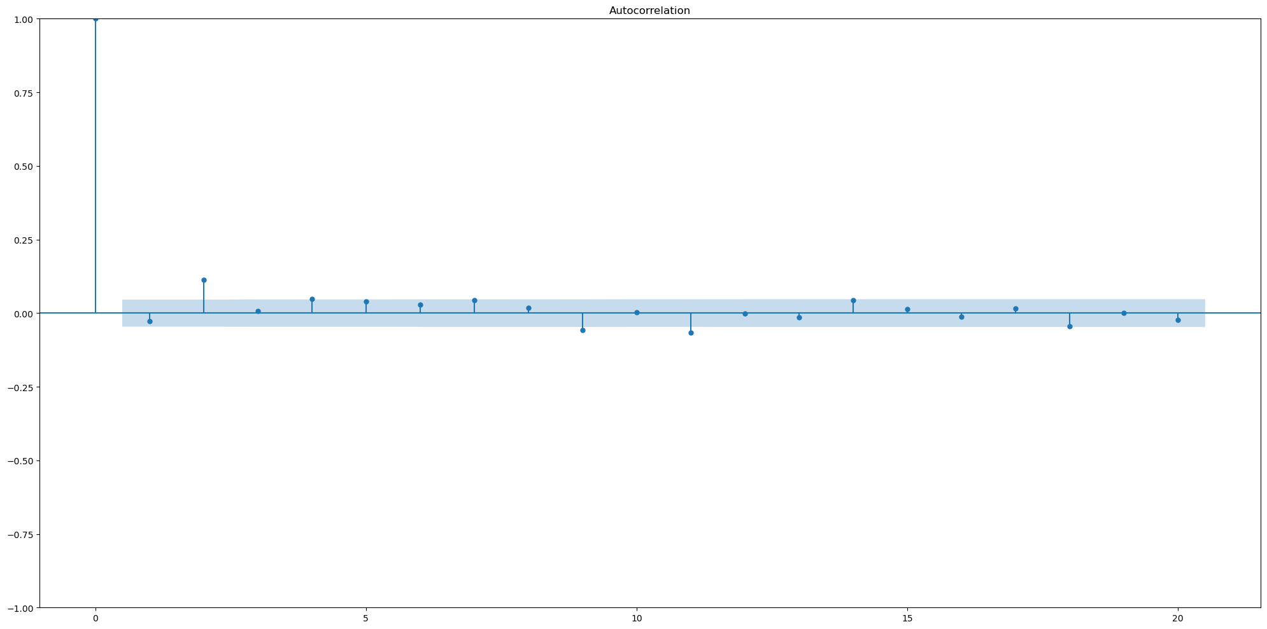
Checking for White Noise
As the p-value for all 3 datasets are less than 0.05, it indicates that there is enough statistical evidence to reject the null hypothesis of no autocorrelation at any of the lags up to 20. This is not consistent with the expected behavior of a white noise time series.
Since the ACF plot for all 3 datasets has significant spikes, this implies presence of autocorrelations between lags.

Slide 10
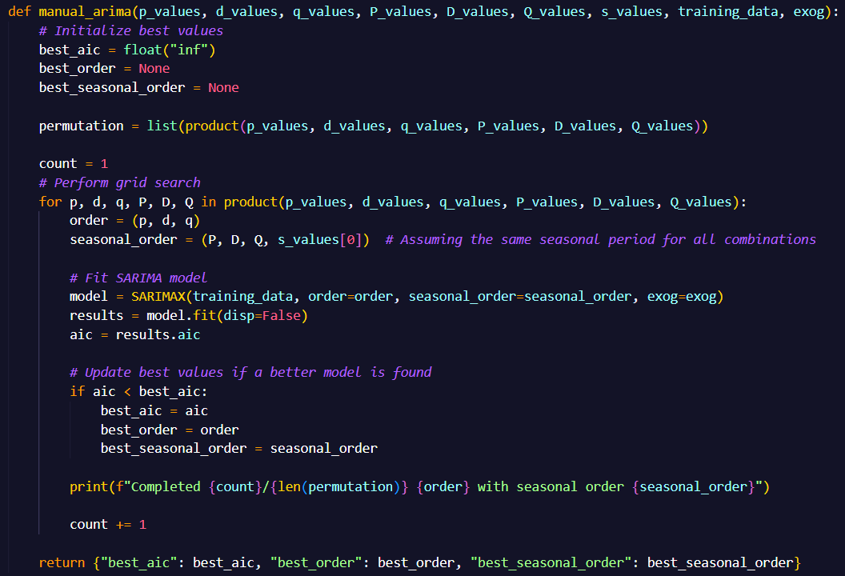
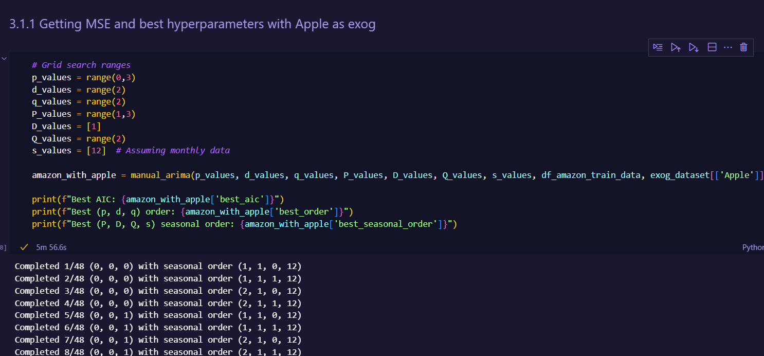
Tuning Hyperparameters Of SARIMAX model
Now, we are in the process of tuning the hyperparameters of the SARIMAX model.
For each time series dataset, it will be tuned 3 times with all possible combination of exog datasets.
The model with the lowest AIC will be returned with its parameter information and AIC score.

Slide 11
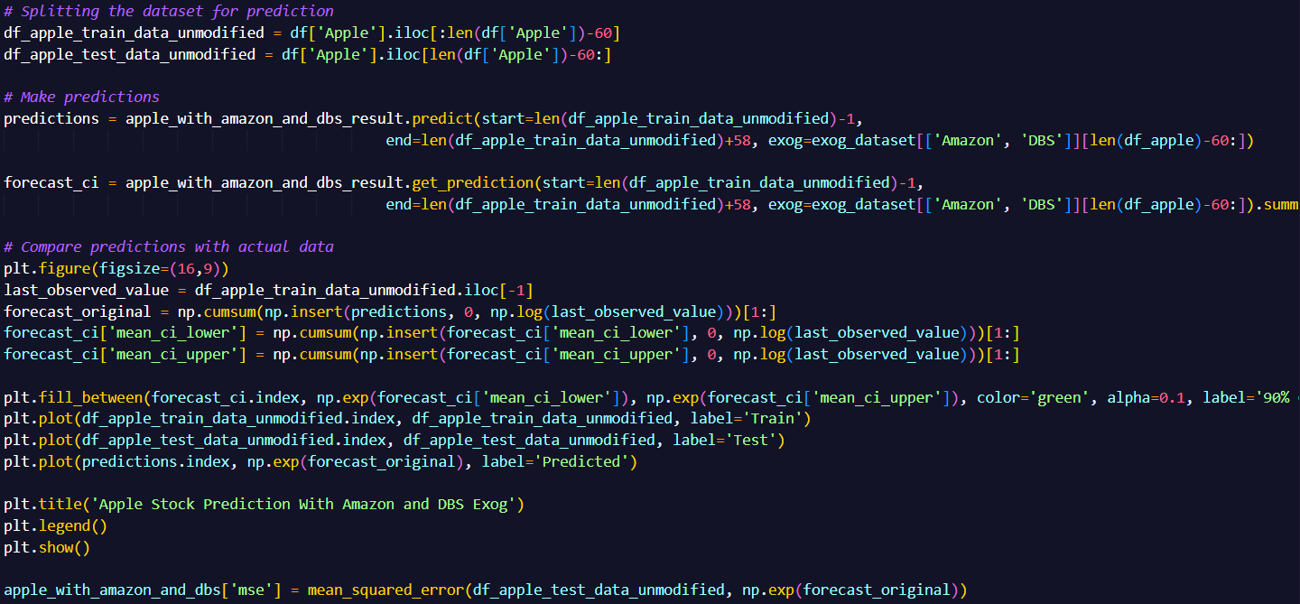
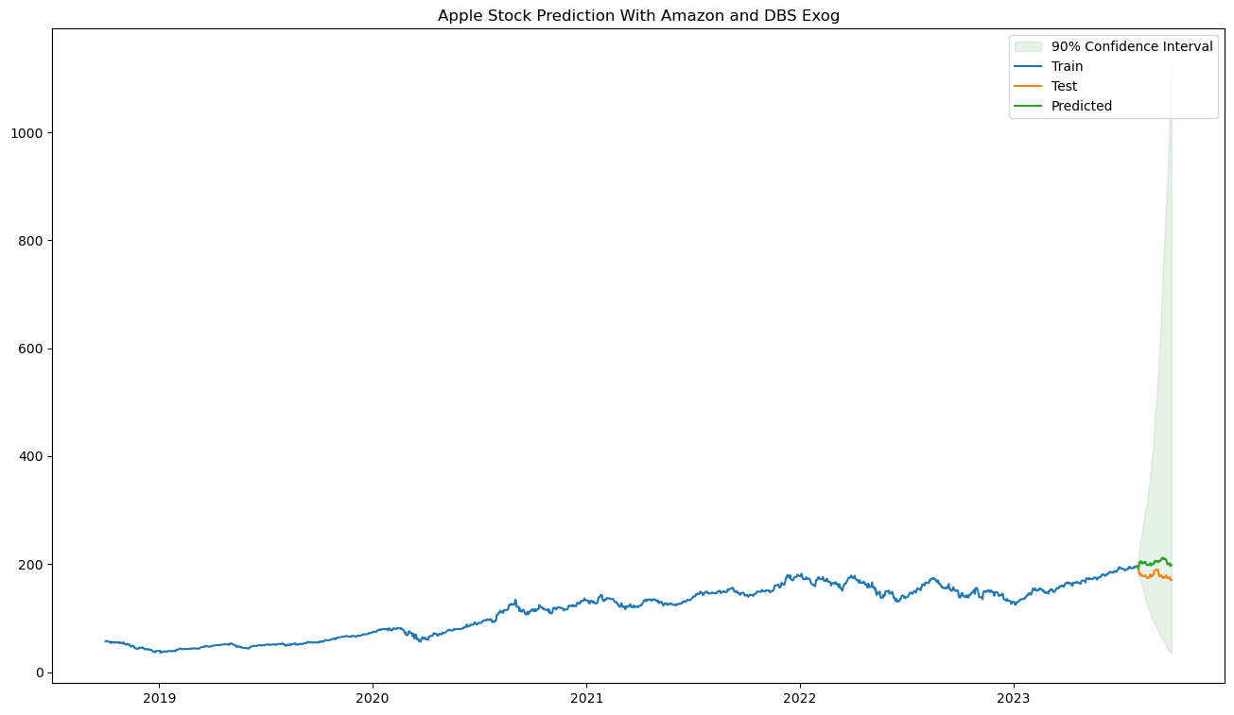
Testing Of Tuned SARIMAX Models
We fit the tuned SARIMAX models with the train data and then ask it to predict 60 days into the future.
The last 60 days of the time series data is the test data set.
After that, the predicted values are matched up with the test dataset to get the MSE value for each model.

Slide 12
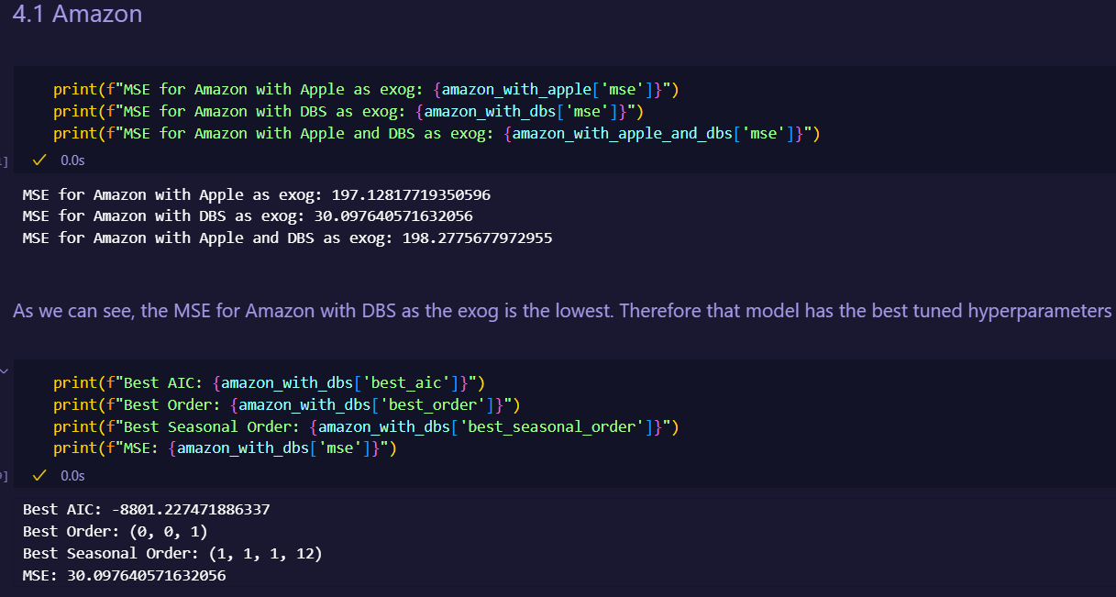
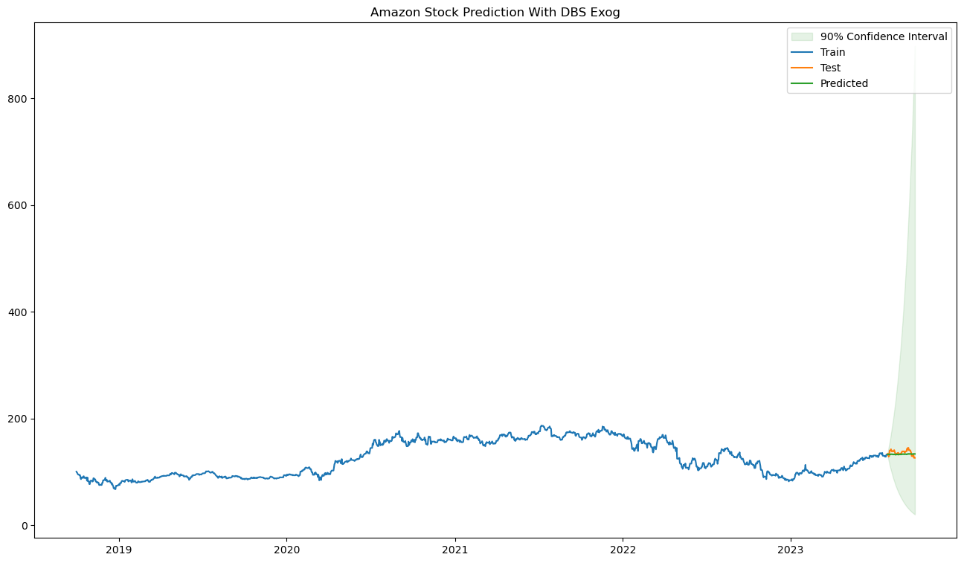
Choosing The Exog Variation with Lowest MSE
For Amazon, the SARIMAX model with DBS as its exog has the lowest MSE value of 30.
It’s order is (0, 0, 1) and seasonal order is (1, 1, 1, 12)
Although you could argue that the predicted line isn't like how a stock time series would look like, it still does capture the general trend of the stock across the next 60 days which I think is more important than getting a model which predictions looks like how a stock would look like but shows an incorrect trend.

Slide 13

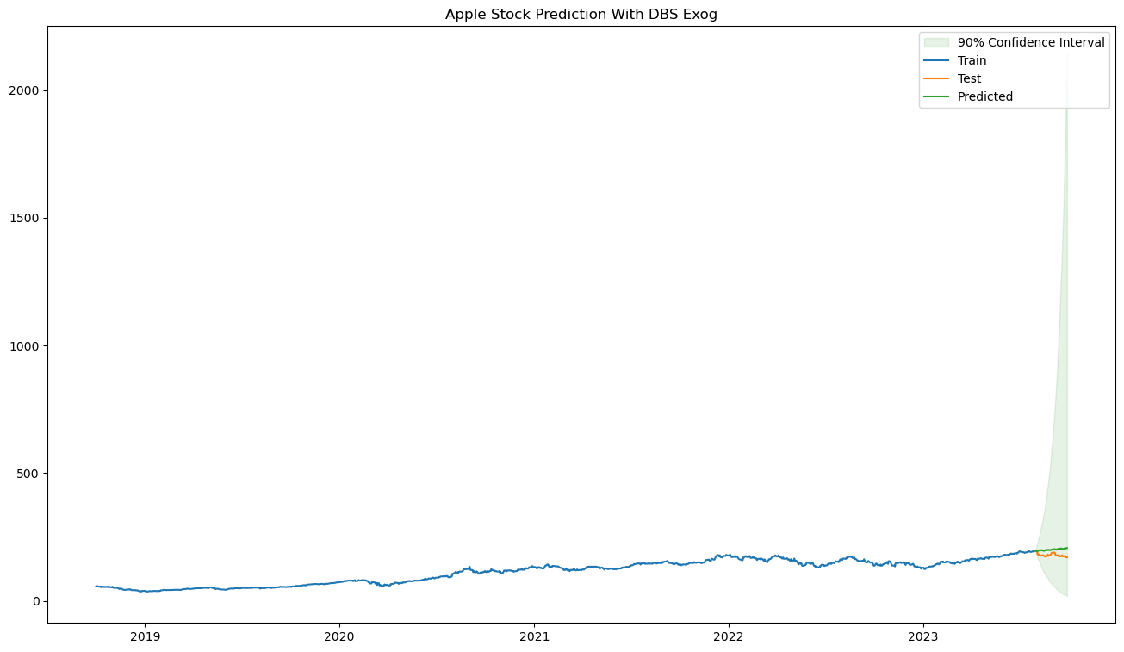
Choosing The Exog Variation with Lowest MSE
For Apple, the SARIMAX model with DBS as its exog has the lowest MSE value of 512.
It’s order is (0, 0, 1) and seasonal order is (2, 1, 0, 12)

Slide 14
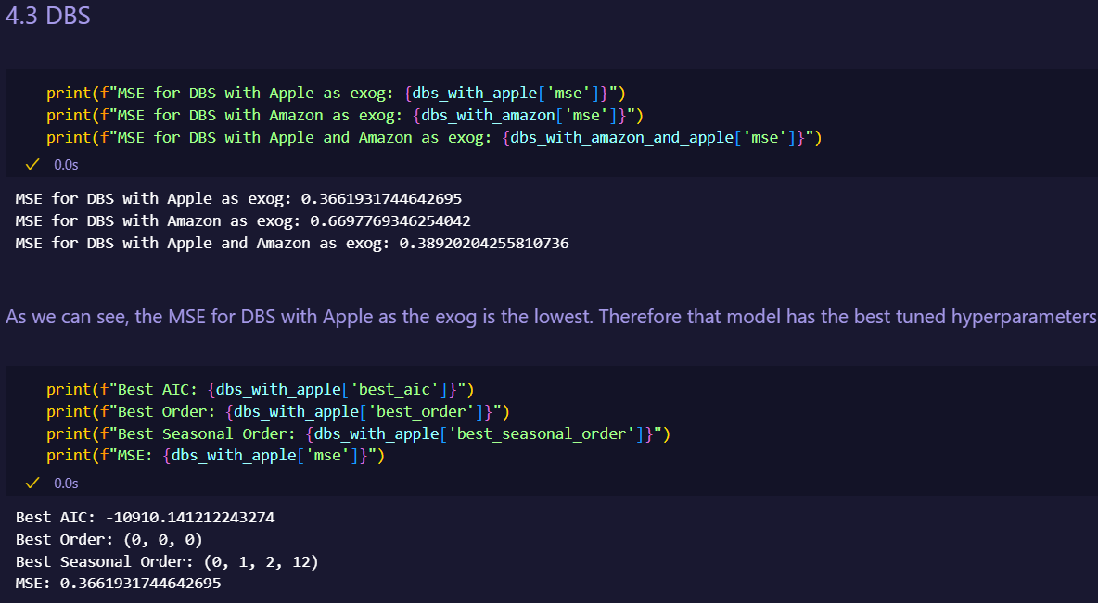
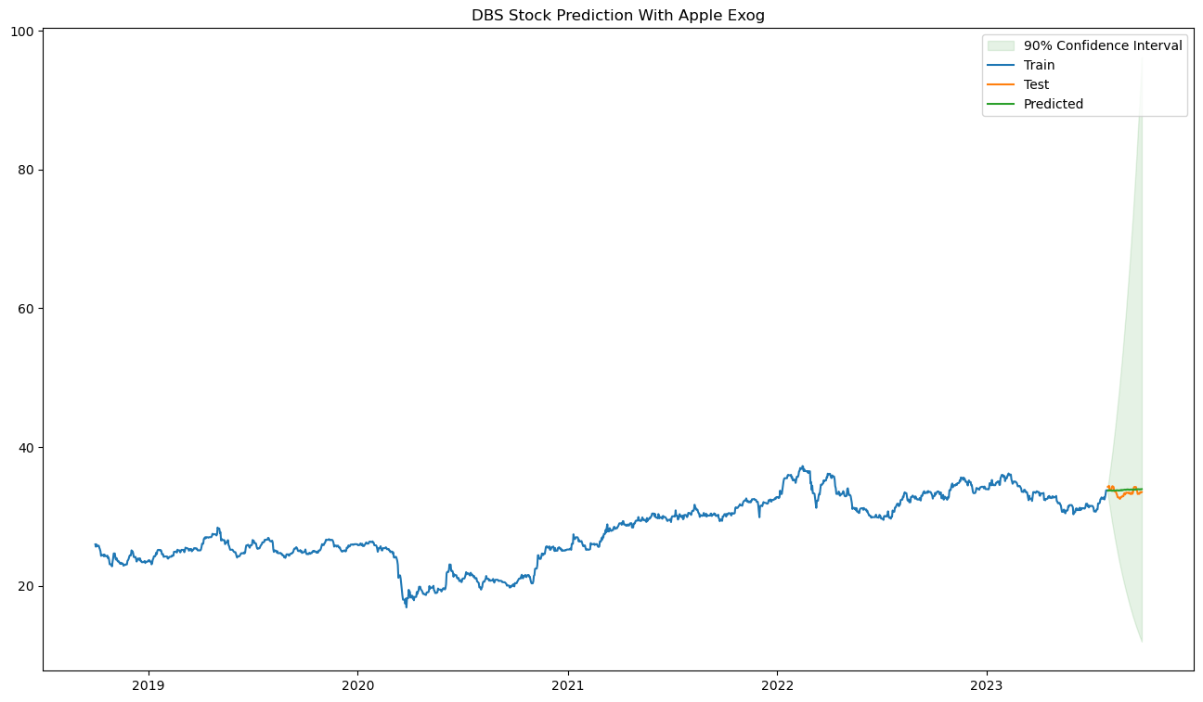
Choosing The Exog Variation with Lowest MSE
For DBS, the SARIMAX model with Apple as its exog has the lowest MSE value of 0.336.
It’s order is (0, 0, 0) and seasonal order is (0, 1, 2, 12).
Although you could argue that the predicted line isn't like how a stock time series would look like, it still does capture the general trend of the stock across the next 60 days which I think is more important than getting a model which predictions looks like how a stock would look like but shows an incorrect trend.

Slide 15
Conclusion
In conclusion, we imported the data, filled in the missing dates value by forward filling, checked if the time series is stationary and whether is it white noise, tuned the SARIMAX model with every possible combination of exog dataset for each time series dataset and predicted 60 days forward before testing it against the test dataset and getting its MSE.
One limitation of using exog is that you would need to know the future values of the exog dataset if you are to predict.

